Slide 1
PRODUCT REVIEW ANALYSIS AND SPAM DETECTION
Names of Students: Major Project Supervisor
Nisheeth Singh Choudhary (9913103458) Mr.Ankur Kulhari
Mukesh Kumar Mishra (9913103462) (Asst.Professor)
Saurabh Mishra (9913103660)

Slide 2
Summary
Product review analysis is one of the key topics for study in recent time. In this project we
focused on classification of reviews and grading them whether they are genuine or not by extracting reviews directly from the website using appropriate tools.
Reviews extracted from the website and then data cleaning was done by removing unwanted punctuations and text. Classification of reviews was done by segregating them as genuine and fake reviews. Classification of reviews along with sentimental analysis increases the accuracy of the system which in turn provides accurate reviews to the user. Next stage after classifying reviews is to rate the reviews using algorithm and presenting them graphically for the better understanding of the user.

Slide 3
Project Phases
Data Extraction
Data Cleaning
Sentiment Analysis

Slide 4
Project Requirements
Beautiful Soup (4.4.0)
Python Libraries
-> CSV
-> RE
-> Division

Slide 5
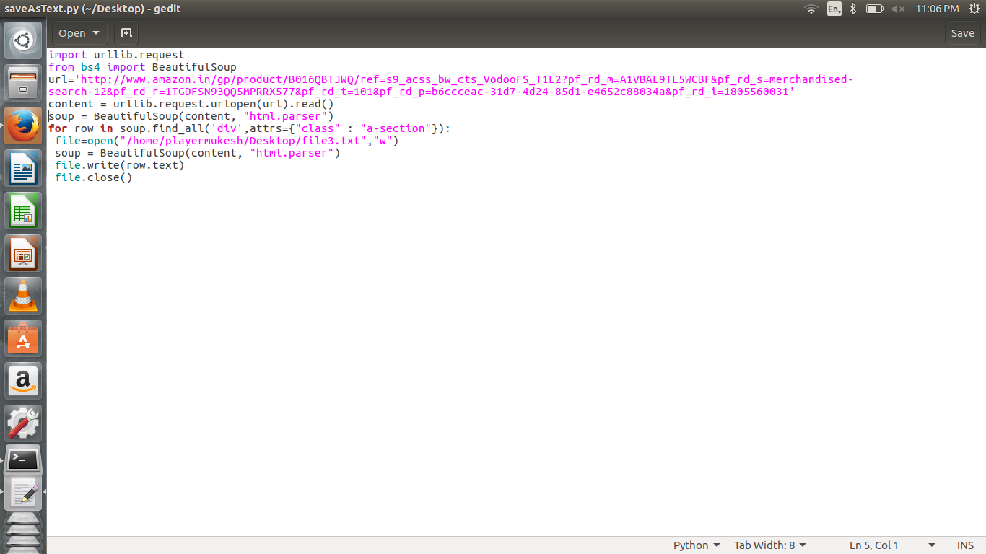
Data Extraction

Slide 6
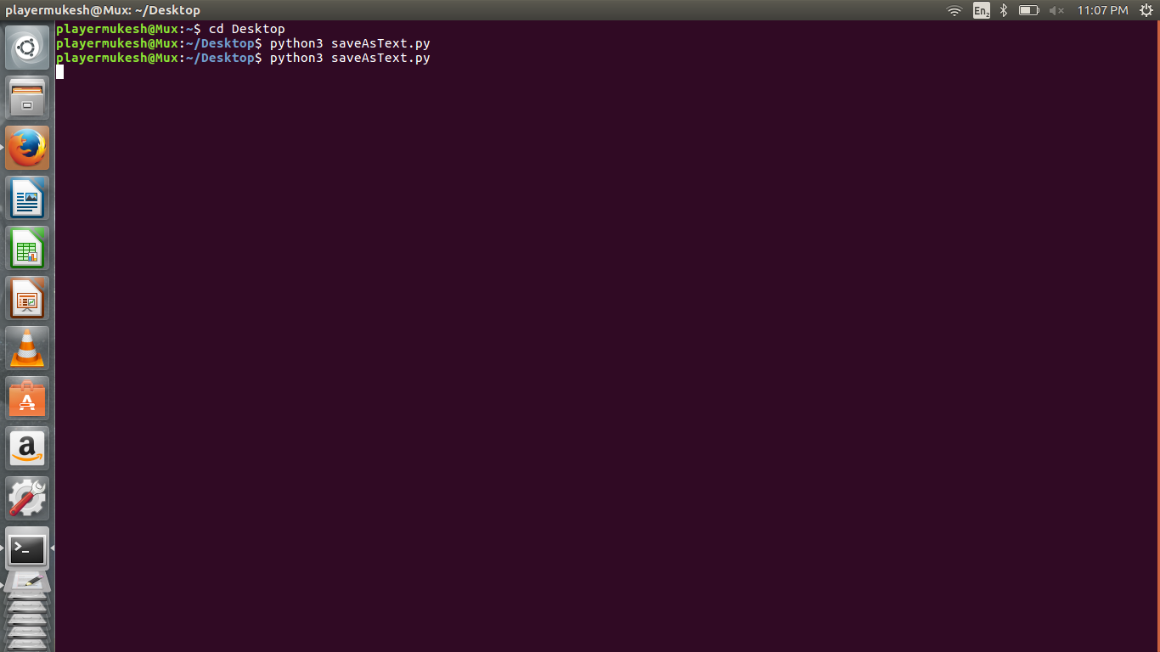

Slide 7
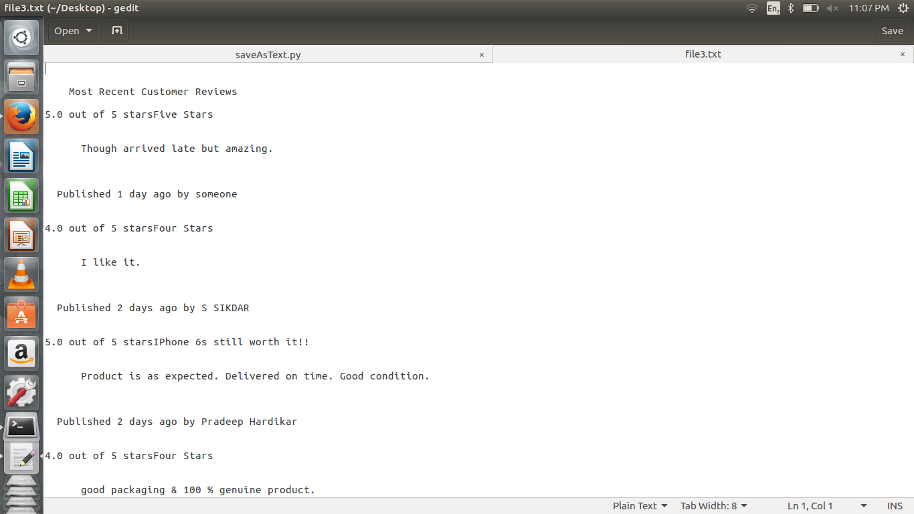
Extracted Data

Slide 8
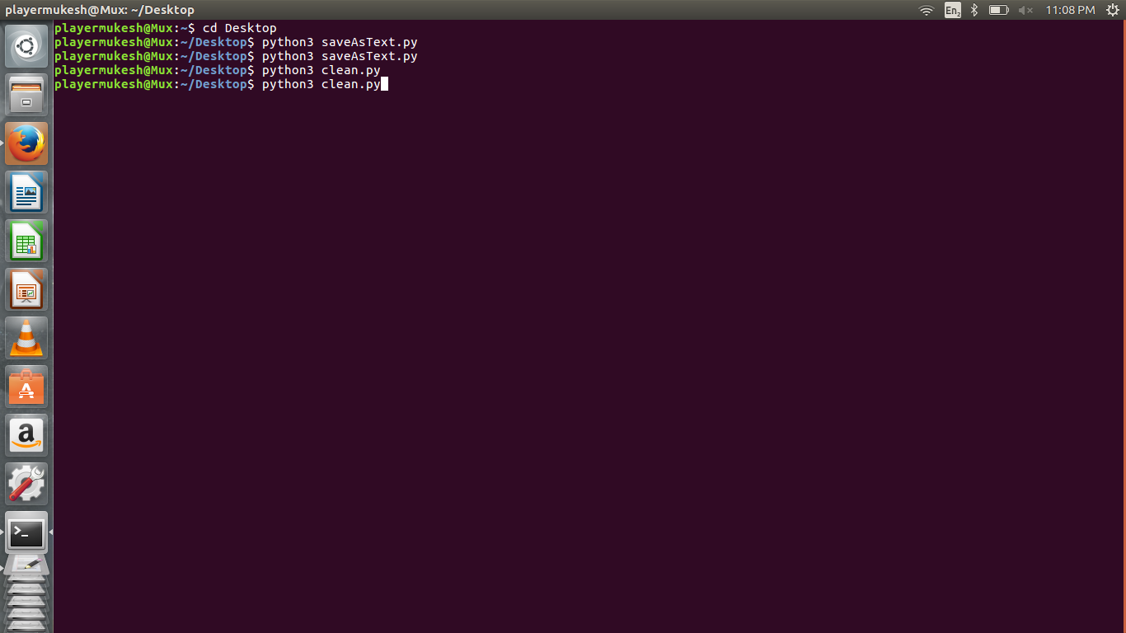
Data Cleaning

Slide 9
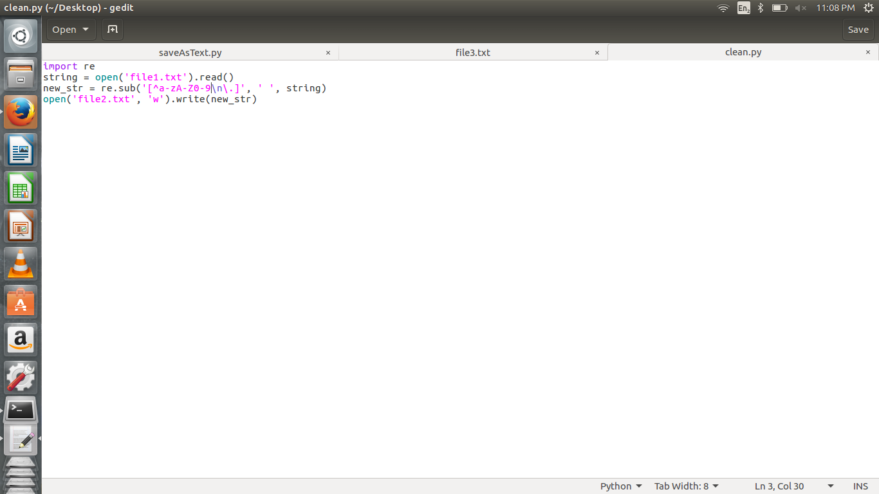

Slide 10
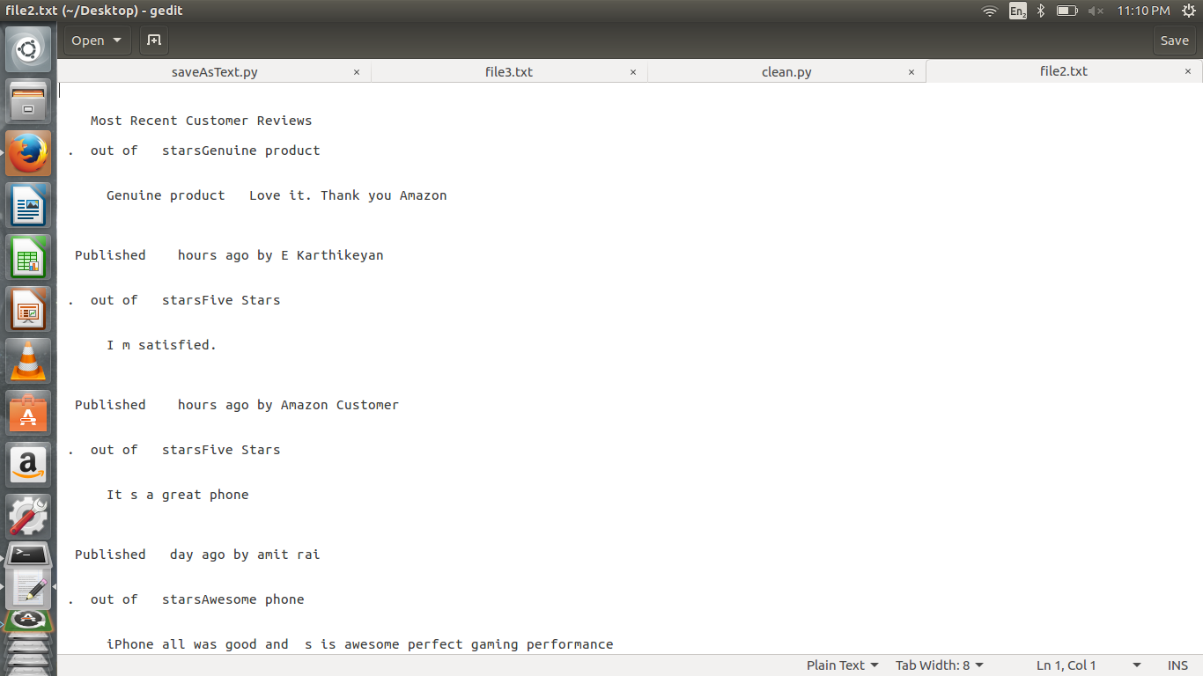
Cleaned Data

Slide 11
Sentiment Analysis

